Slide 1
Standard User –
Activities, Delegate, Withdraw, Restore
February, 2013

Slide 2

Learning Objectives
Upon completion of this course you will be able to:
  Display Contract Activities List
  View and Understand the Activity Log
  View Pending Tasks from the Contract Editor
  View Pending Tasks from the Home Page
  Update Substatus
  View Approval Status
  Restart Approval Task
  Delegate Tasks
  Delegate Out of Office Responsibilities
  Cancel the Delegated Tasks
  Withdraw a Contract
  Restore a Withdrawn Contract

Slide 3

Manage the Contract Lifecycle
Keeping track of multiple contracts that are in different stages of the lifecycle can be difficult.
There are several tools within ECM that help you with this activity and provide information about your contracts.
These tools include:
  An Activity list
  The Pending Task list
  The contract sub-status
  The Approval status
  The Contract Properties

Slide 4
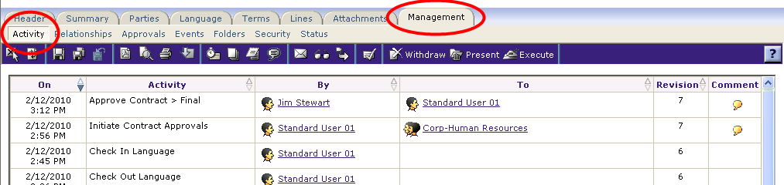
Contract Editor - Management Tab
With a contract opened in the Contract Editor, click the Management tab.
The Tabs available within the Management tab include:
  Activity
  Relationships
  Approvals
  Events
  Folders
  Security
  Status

Slide 5
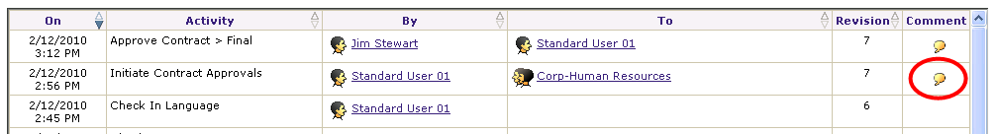
Activity Log
The Activity Log shows all activities associated with the contract. Included are:
  The “time stamp” for the activity to help identify when the activity was performed
  The task or activity
  Who performed the activity
  Any recipient of the activity
  The Revision created by the activity, and
  The task comment, if any.
To display the comments associated with an activity, click the Comment “bubble” beside the activity.

Slide 6
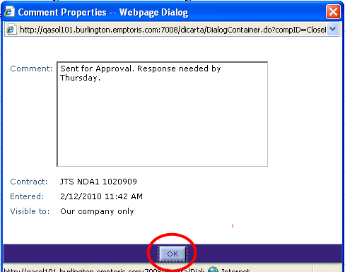
Activity Log – Read Comments
The Comment Properties dialog box is displayed.
From here, you can read a comment about a specific task to clarify any changes or results of a task.
Click OK when done.

Slide 7
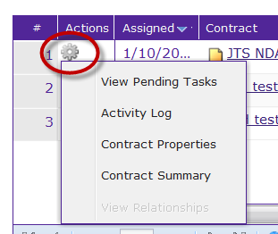
View Activities from Home Page
You can review the Activities list from the Home page My Tasks portlet.
  This is useful if reviewing several contracts to see what recent activities have occurred.
To display a list of activities:
  Click the icon in the Actions column next to the Contract Name in the Task list.
  The Actions menu is displayed.
  Click the Activity Log item. The Activity Log is displayed.

Slide 8
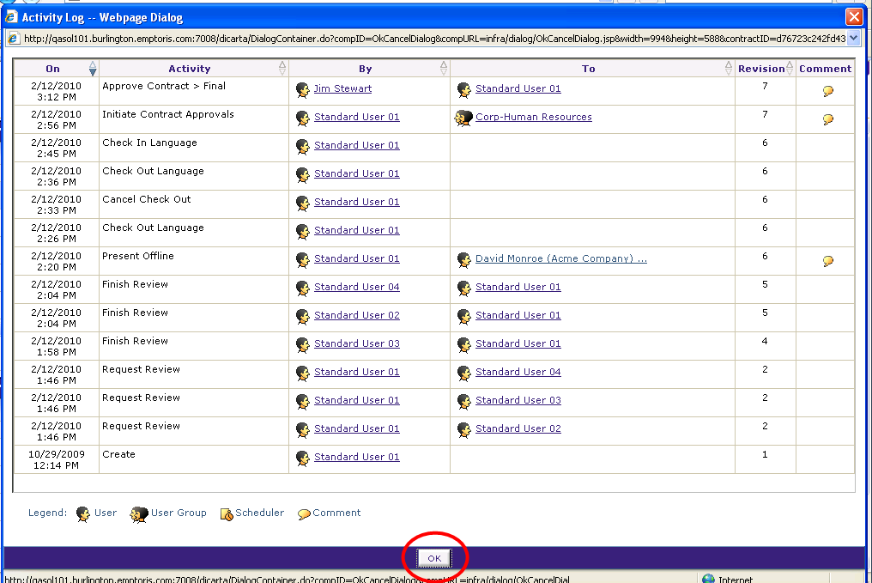
Activity Log
The Activity Log is the same display as the one accessed from the Management tab.
View the Activities for the selected contract.
Click OK when done.

Slide 9
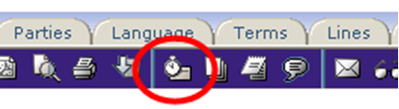
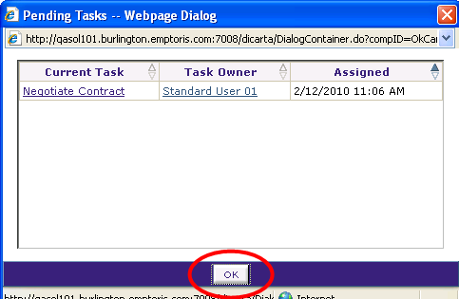
View Pending Tasks from Contract Editor
The Pending Tasks dialog box can be displayed from within the Contract Editor.
On the main, blue toolbar, click the Pending Tasks icon.
The Pending Tasks dialog box
is the same as displayed
from the Home Page.
Click OK when done.

Slide 10

Update Substatus
Some contract Status values (especially Draft and In Negotiation) are rather broad and do not necessarily reflect the activity taking place within the scope of the particular Status. Also, the Status values cannot (easily) be changed, so adding and using Substatus values can be an effective way to tailor the system.
The Substatus setting can be used to clarify the Status settings. It can also be used to trigger Notifications, if contract status is Draft or In Negotiation.
Substatus values are never updated by ECM directly. To set one, click the Update Substatus icon from the main, blue toolbar of the Contract Editor.
The Update Substatus dialog box is displayed.

Slide 11
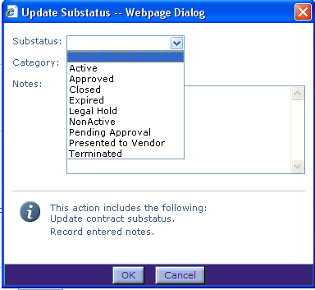
Update Substatus Dialog Box
The Substatus drop-down menu contains a list of predefined values.
  These are configurable by client
You can select the value that is appropriate for the contract activity.
  Click the Substatus drop-down menu.
  Select an item that is appropriate to the contract task.
  Optionally, add a Note about the Substatus value or task.
  Click OK when done.
  The Substatus value is added to the contract Status

Slide 12

Update Substatus Value
You can use the Substatus value to give you a quick, more detailed view of the status of all of the contracts that you manage.
“[Status] > [Substatus]” is the format used to display these values in the Contract Editor (as above) and also the Status column of “My Tasks”

Slide 13
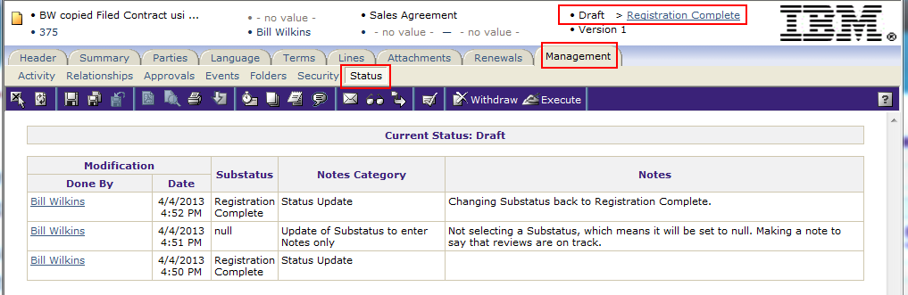
Substatus Configuration
Configuration:
  Add your own Substatus values via Administration > Configuration > Value Lists > ContractSubStatus
  You can add your own Categories for the Notes you add. Do this at Administration > Configuration > Value Lists > ContractStatusNotesCategory. Each Substatus update, including the related Notes Category value, is reflected in the Contract Editor, in Management > Status.

Slide 14
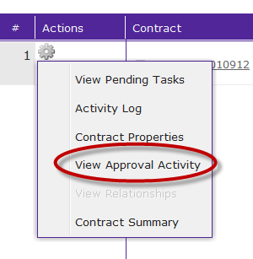
View Approval Status
You can view the status of your Approval Requests from the Detailed Search or Folder screen or from the Management tab > Approvals sub-tab.
  From the Home Page, click the Search icon and select the Detailed Search option. The Search screen is displayed.
  Enter the criteria to search for the contracts you would like to view. For this example, we enter “JTS” to search for all contracts that start with these initials.
  Click Search button. The contracts matching out criteria are displayed.
  Click the Actions icon next to the Contract Name.
  The Actions menu is displayed.
  Select the View Approval Activity menu item.

Slide 15
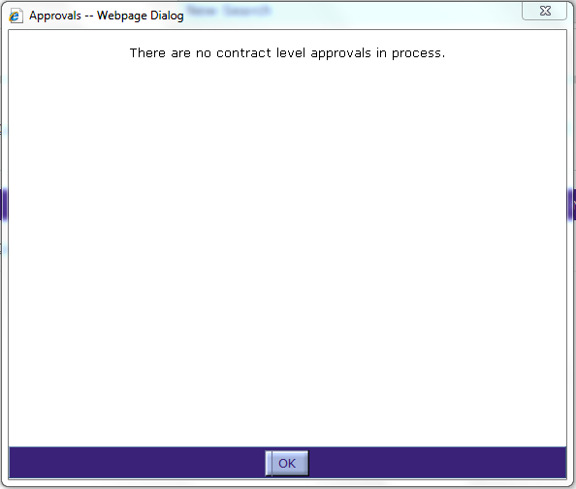
View Approval Status, cont.
The Approval Status dialog box is displayed.
  If the contract is already approved, then the message: There are currently no approvals in process is displayed.
If there are pending approvals, the list is displayed.
  Click in the row of the approval task to select it.
  Click the Cancel button to cancel the selected approval task.
  Note: This option also exists on the Management tab of the contract editor window.
  Click OK to close the Approvals dialog box.

Slide 16
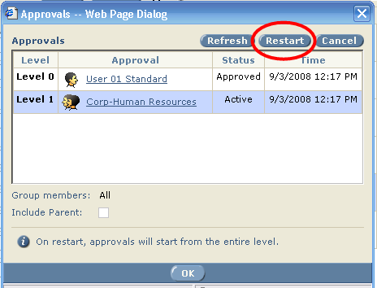
Restart the Approval Task
To restart the approval task:
  Click in the row of the task to highlight it.
  Click the Restart button.
  The approval task is re-initiated and messages are re-sent to the approvers.
  Click OK to close the Approvals dialog box.

Slide 17

Delegate Tasks Overview
ECM tracks the contract-related tasks that you generate or are assigned to you from another user.
These tasks, displayed in the My Tasks portlet, may be time sensitive and need to be addressed quickly.
In the event that you are out of the office for a prolonged period of time, you may delegate responsibility to another user for each of the selected Task types (Approve, Review, Draft, or Negotiate).
Note that when you delegate tasks, the recipient(s) will not necessarily have the permissions needed to perform the task. To prevent this problem, an administrator can cause permissions to be “delegated” as well (Administration > Application > System Settings > Workflow).

Slide 18
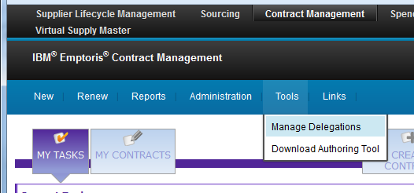
Delegate Tasks
To delegate tasks, from any home page of the Contracts application:
  Select the Tools menu, and click the Manage Delegations link.
The Delegate Task dialog box is displayed.

Slide 19
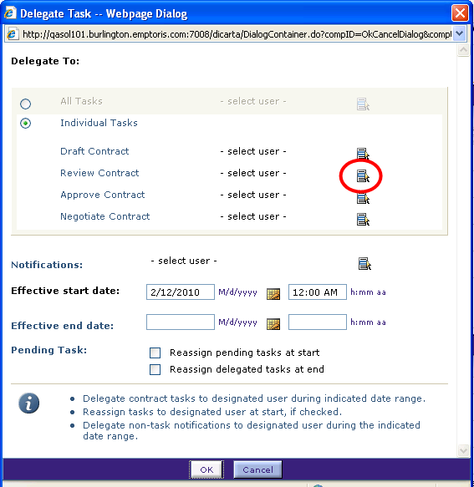
Delegate Tasks Dialog box
You may choose to delegate all of your contract tasks to a single person or delegate specific tasks to specific users.
  Click the All Tasks or Individual Tasks radio button as needed.
  For this example, we clicked the Individual Tasks radio button.
  Click the Select icon for the Task Type that you want to Delegate.
  For this example, we clicked the Select icon for the Review Contract task.

Slide 20
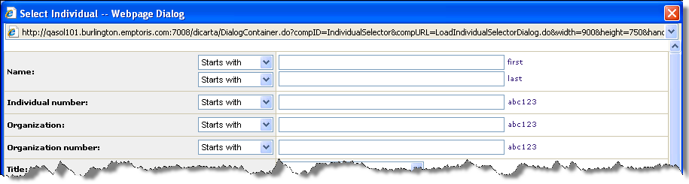
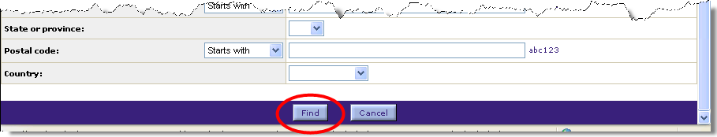
Select Individual
Enter a Name or Partial Name or other criteria for the user.
Or leave all of the fields blank to display a list of all available users.
Click the Find button.

Slide 21
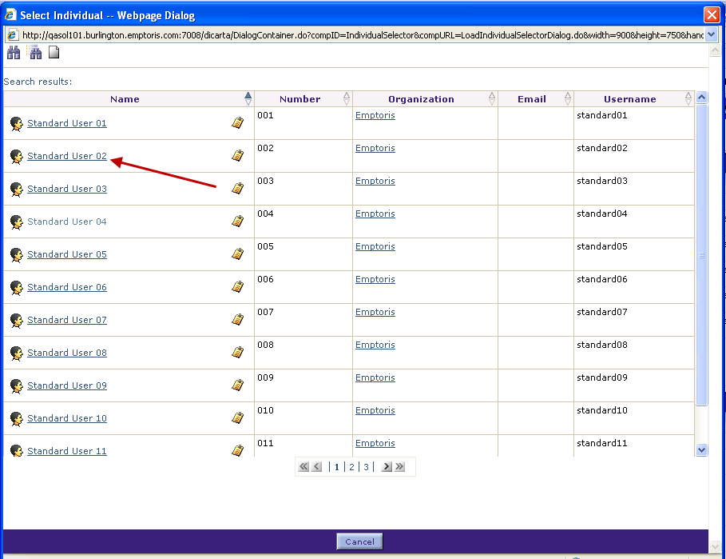
Select Individual, cont.
Use the page number buttons or chevron arrow buttons to navigate to the page with the user’s name.
Click user name hyperlink to select the user.

Slide 22
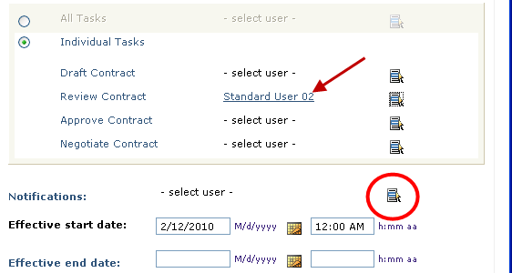
Delegate Tasks, cont.
The selected user’s name is added to the Delegate Task dialog box.
Continue selecting users for other tasks as needed.
Click the Select icon to select the user to receive any Non-Task Notifications.
  The Select individual dialog box is displayed.
Select the individual using the same procedure as above.

Slide 23
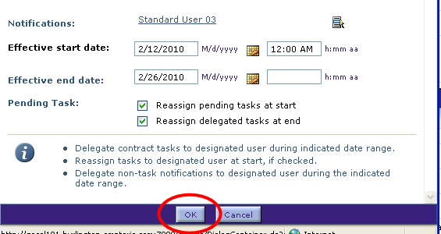
Delegate Tasks, cont.
The selected user’s name is added to the dialog box for Notifications.
Select the Dates when you will be out of the office and the user is delegated the specific tasks. Use the Calendar icons to select the dates.
Click the check box to delegate any open, pending tasks to the user when the Effective Start Date has passed.
Click the check box if you want to reassign any open tasks back to you when you return and the Effective End Date has passed.
Click the OK button when done.

Slide 24
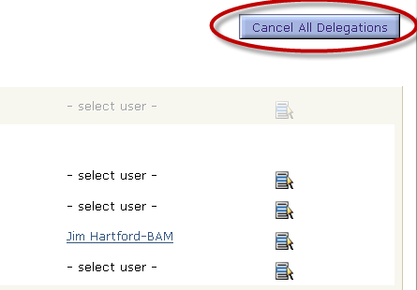
Delegate Tasks, cont.
When you return, or wish to cancel the Delegated Tasks:
  Click the Manage Delegations option from the Tools menu.
  Click the Cancel All Delegations button in the upper right corner.
  The confirmation dialog box is displayed.
  Click OK to verify that the task delegation should be cancelled.
  Click Cancel to close the Manage Delegation dialog box.

Slide 25
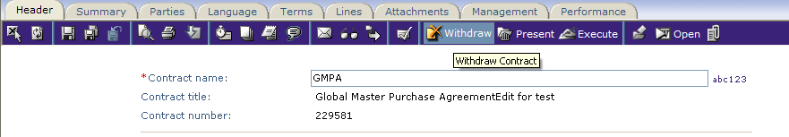
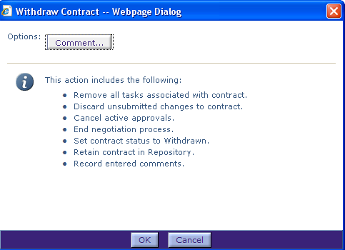
Withdraw a Contract
At any time prior to the contract being Executed, the contract may need to be withdrawn due to various reasons (e.g. Project cancelled; review process turned up an issue, etc.).
This can be done with the Withdraw option.
Click the Withdraw icon on the main, blue toolbar.
The Withdraw Contract dialog box appears.
Click the Comment… button

Slide 26
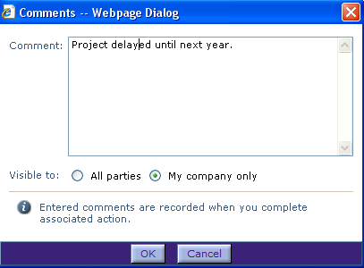
Withdraw a Contract, cont.
Enter detailed comments as to why the contract is being withdrawn.
Click OK when finished.
Review the information display which provides a detailed list of the actions taken when the contract is Withdrawn.
  Any changes, tasks, negotiation and approval processes are cancelled, the contract status is changed to Withdrawn with comments recorded, and the contract is retained in the Repository.
Click OK to Withdraw the contract.
Be sure to Save your changes and close the contract.

Slide 27
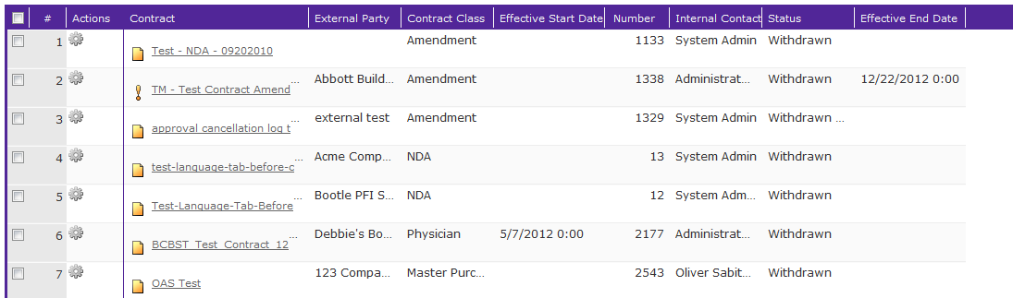
View Contract Status
In the My Contracts section on the Home Page, the contract status now reflects Withdrawn.
Click on the contract name link to open the contract and view any comments associated with the contract.

Slide 28

View Comments
Click the Comments icon.
The Comments dialog box opens.
The reasons for the contract being withdrawn are displayed.

Slide 29
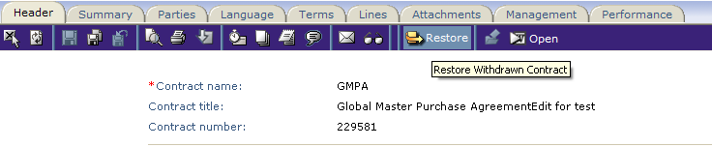
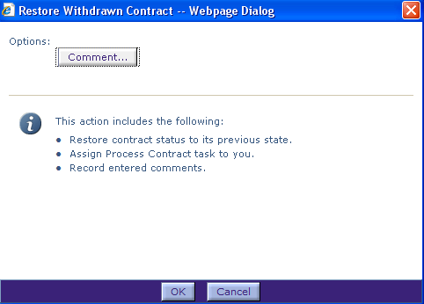
Restore a Withdrawn Contract
A Withdrawn contract can be restored when appropriate.
Open the contract and click the Restore icon on the main, blue toolbar.
The Restore Withdrawn Contract dialog box is displayed.
Click the Comment… button.

Slide 30
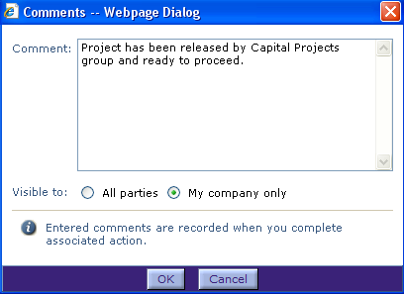
Restore a Withdrawn Contract
Enter your comments as to why the contract is being restored.
Select if the comments are Visible to All parties (external and internal) or within the company only Click OK.
The Restore Withdrawn Contract box is again displayed. Click OK.
Be sure to Save your changes and close
In the My Contracts section on the Home Page, the contract status now reflects Draft status, indicating the contract has been restored.
Click on the contract name link to open the contract and view any comments associated with the contract.

Slide 31

Questions?

